Slide 1



OWASP en .NET: Security Configuration and Sensitive Information Handling

Slide 2
Agenda
Recapitulación
Manejo insuficiente en la capa de transporte (TLS/SSL)
Métodos de prevención
Ejemplos prácticos.
info@megsoftconsulting.com

Slide 3
Recapitulación

Slide 4
Top 10 OWASP
Injection
Weak authentication and session management
XSS
Insecure Direct Object References
Security Misconfiguration
Sensitive Data Exposure
Missing Function Level Access Control
Cross Site Request Forgery
Using Components with Known Vulnerabilities
Unvalidated Redirects and Forwards

Slide 5
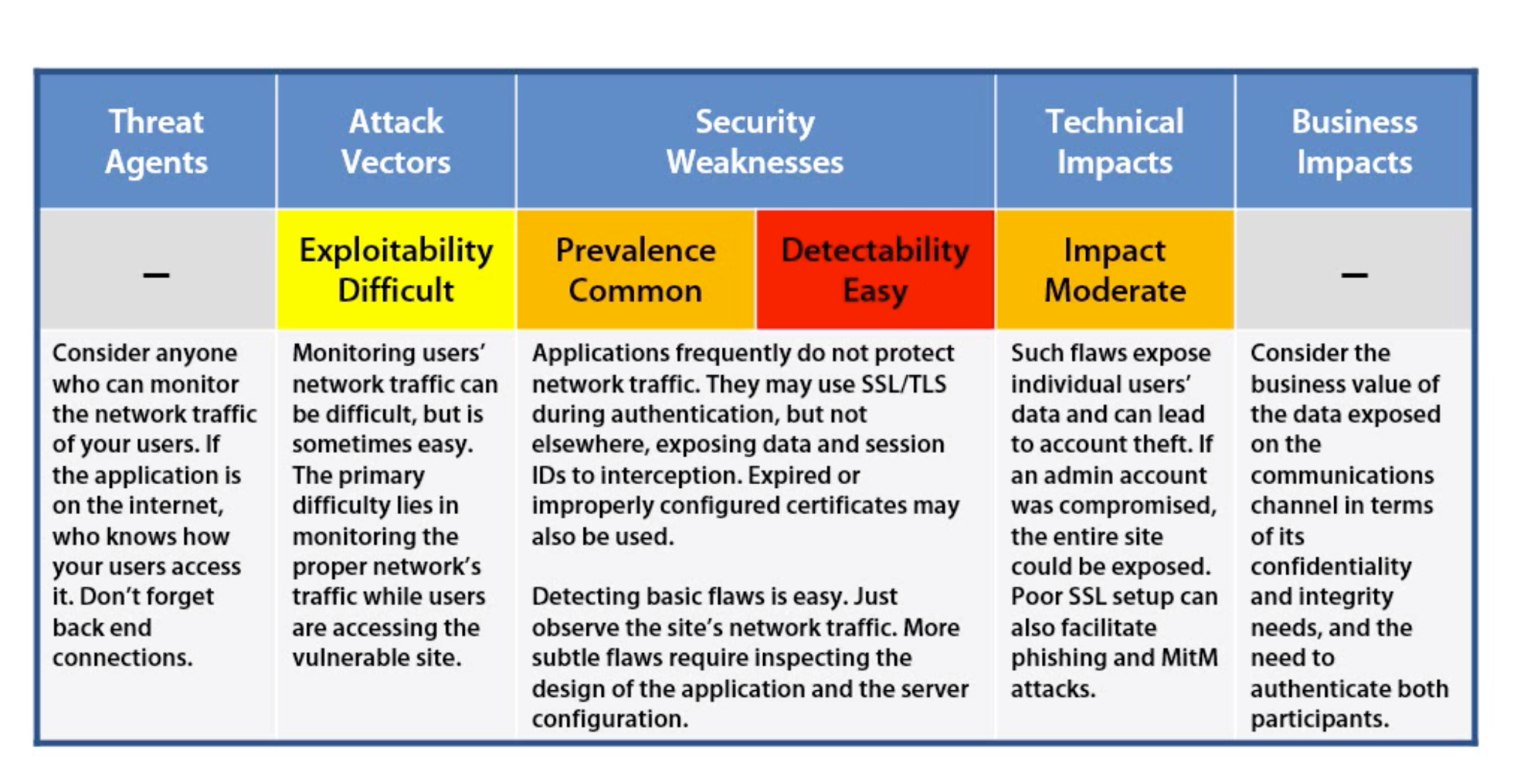

Slide 6
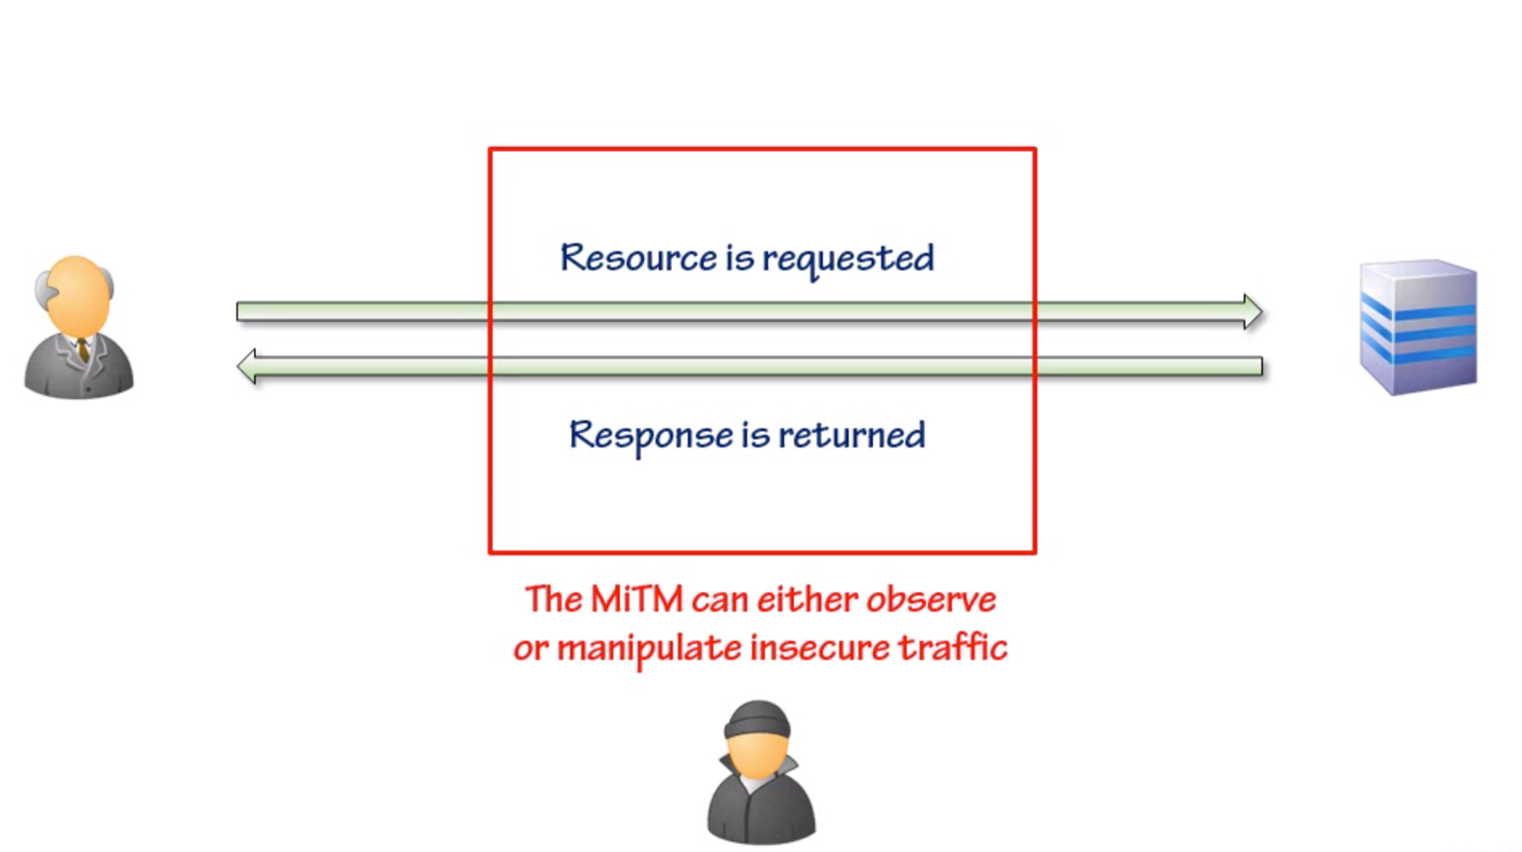

Slide 7
Métodos de prevención

Slide 8
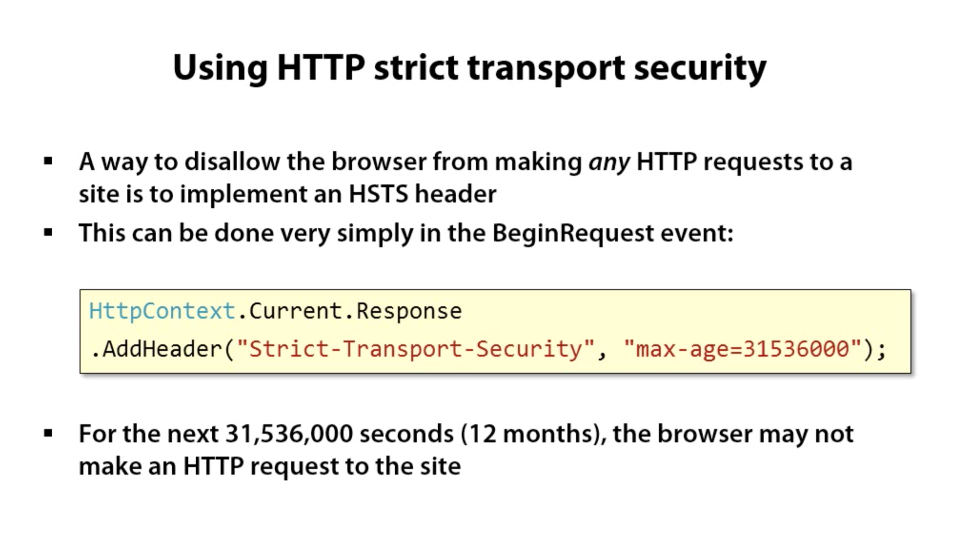

Slide 9
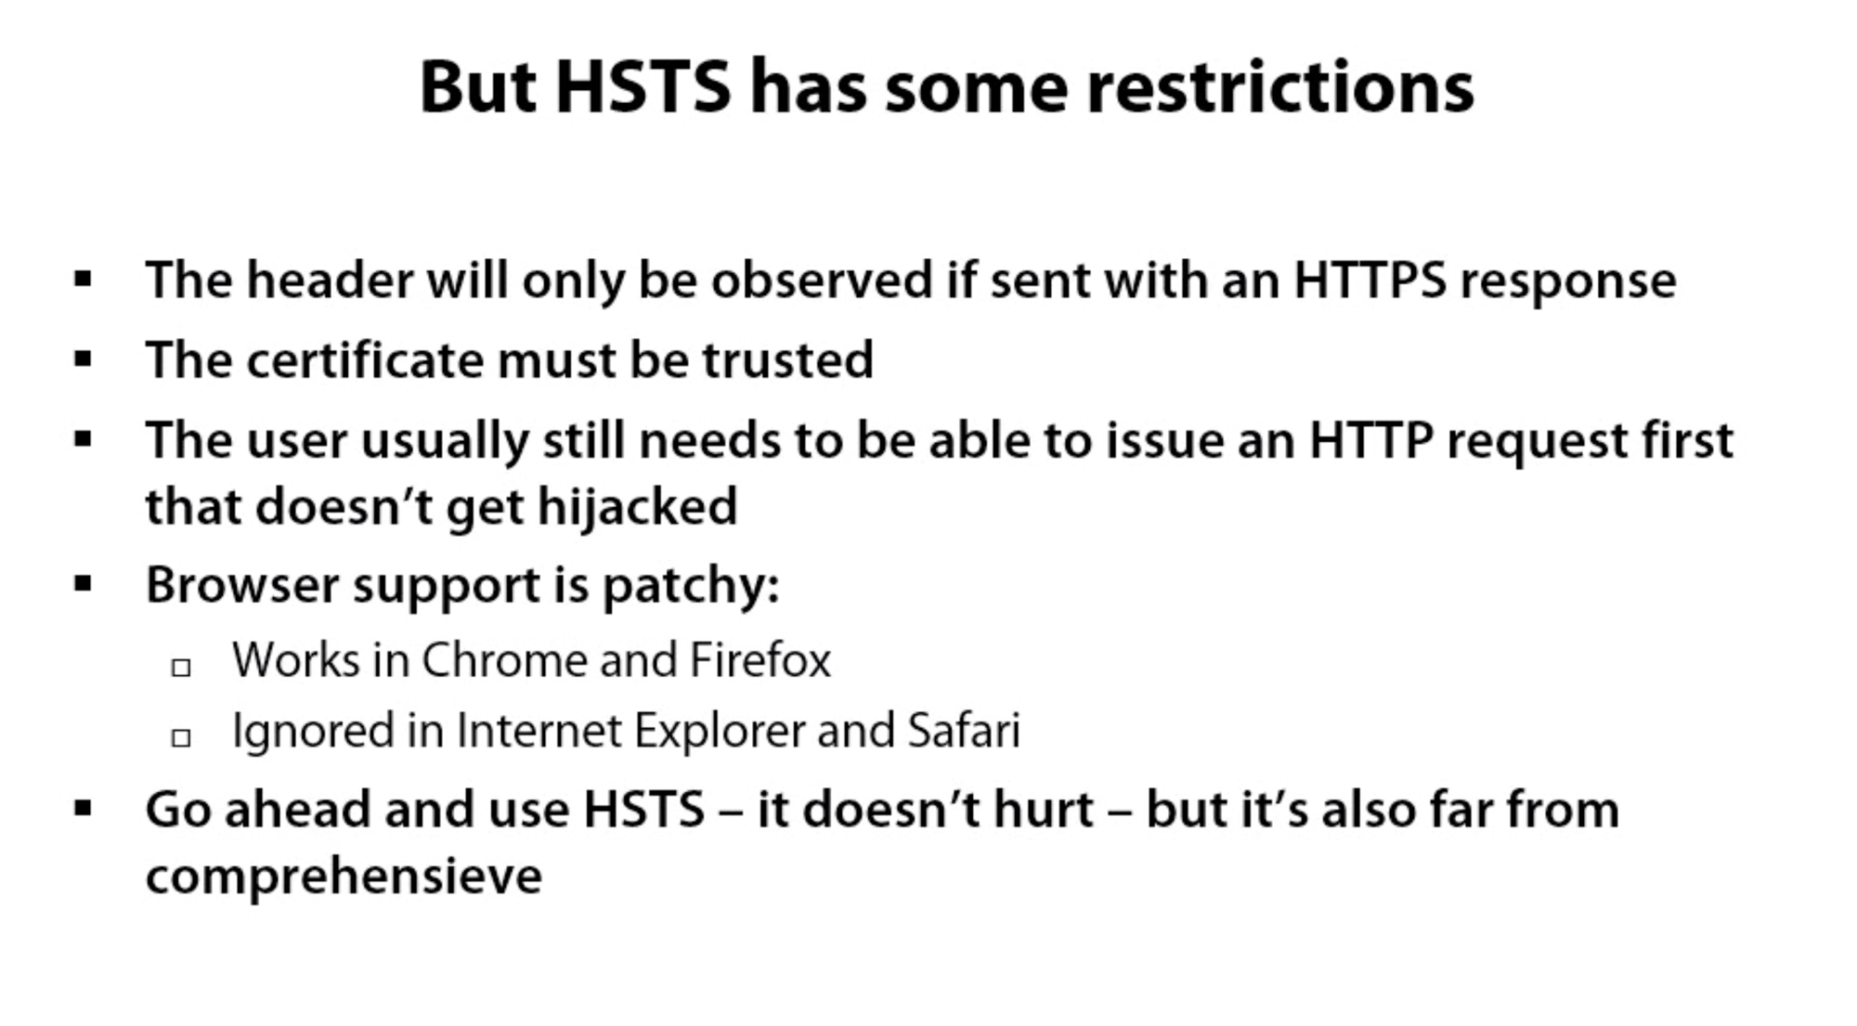

Slide 10
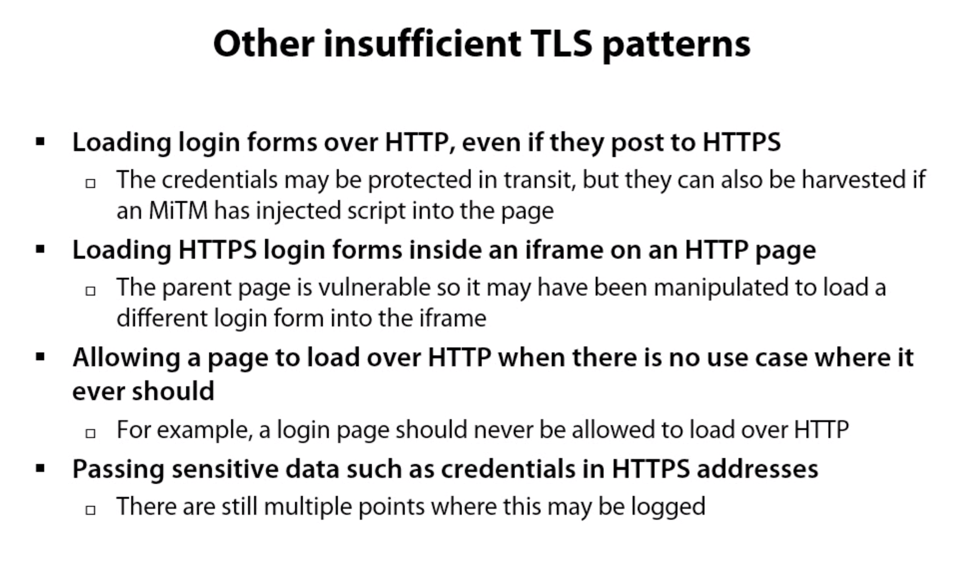

Slide 11


Slide 12
What’s next?
Third party components and packages

